Slide 1
TEXT ANALYTICS
Dr.E.Sivasankar, NIT,Tiruchirappalli-15

Slide 2
Sentiment Analysis
Sentiment Analysis (SA) is the computational study of people’s opinions, attitudes and emotions toward an entity.
The process of computationally identifying and categorizing opinions expressed in a piece of text, especially in order to determine whether the writer's attitude towards a particular topic, product, etc. is positive, negative, or neutral.

Slide 3
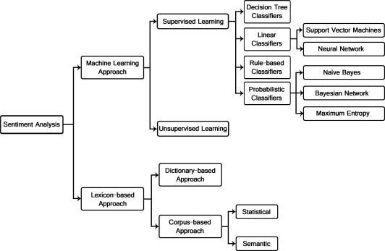

Slide 4
Lexicon Based Approach - Dictionary based approach
The dictionary-based approach depends on finding opinion seed words, and then searches
the dictionary of their synonyms and antonyms.
R1: The phone’s design is the best I’ve seen so far, 1
[('The', 'DT'), ('phone’s', 'NN'), ('design', 'NN'), ('is', 'VBZ'), ('the', 'DT'), ('best', 'JJS'), ('I’ve', 'NN'), ('seen', 'VBN'), ('so', 'RB'), ('far', 'RB')]
Steps:
1. Tokenize the words. R1: <phone, design,best, see, far>
2. POS tagging.
3. Filter the tags like ADV, V, NN, ADJ.
[('phone', 'NN'), ('design', 'NN'), ('best', 'JJS'),('seen', 'VBN')]

Slide 5
Lexicon Based Approach - Dictionary based approach
4. Based on the word and tag in each review,
4.1 Lemmatize
4.2 Find the synset of the word by using the function call swn.senti_synset(synset.name())
phone: n 02992529 0 0 mobile_phone#1
design: n 00928077 0 0 designing#1
best: a 00227507 0.75 0 best#1
(superlative of `good')
see: v 00598954 0 0 see#6
pick_up#5 learn#
4.3 senti_score = senti_score+ swn_synset.pos_score()- swn_synset.neg_score().
= 0+0.75-0=0.75
5. if senti_score >=0 return 1 [as positive]
else return 0 [as negative]
here senti_score>0, return 1 as positive.
6. Do steps 1 to 5 for all the reviews.

Slide 6
Data Pre-processing
1. Tokenization-The process of breaking a stream of text into words or other meaningful elements called tokens is called Tokenization.
2. Removal of Stop-words-When data analysis needs to be data driven at the word level, the commonly occurring words (stop-words) should be removed.
3. Parts-Of-Speech Tagging- It is also called word-category disambiguation. It is the process of marking up a word in a text or corpus as corresponding to a particular part of speech, based on both its definition, as well as its context that is relationship with adjacent and related words in a phrase, sentence, or paragraph. After tagging the tokens with their POS, only the tokens whose POS is among Noun forms, Adjective forms, Adverb forms are chosen.

Slide 7
Feature weighting
Each and every feature has different capabilities to classify the review accurately. The ability of each feature has been measured by Feature Weighting schemes. They are,
Document–Term Matrix: A document-term matrix is a mathematical matrix that describes the frequency of terms that occur in a collection of documents. In a document-term matrix, rows correspond to documents and columns correspond to terms.

Slide 8
Term Frequency–Inverse Document Frequency (TF-IDF) Matrix: In information retrieval, TFIDF is a numerical statistics that is intended to reflect how important a word is to a document in a collection or corpus.
  Term frequency: In the case of the term frequency tf(t,d), the simplest choice is to use the raw count of a term in a document, i.e. the number of times that term t occurs in document d.
  The inverse document frequency is a measure of how much information the word provides, that is, whether the term is common or rare across all documents.

Slide 9
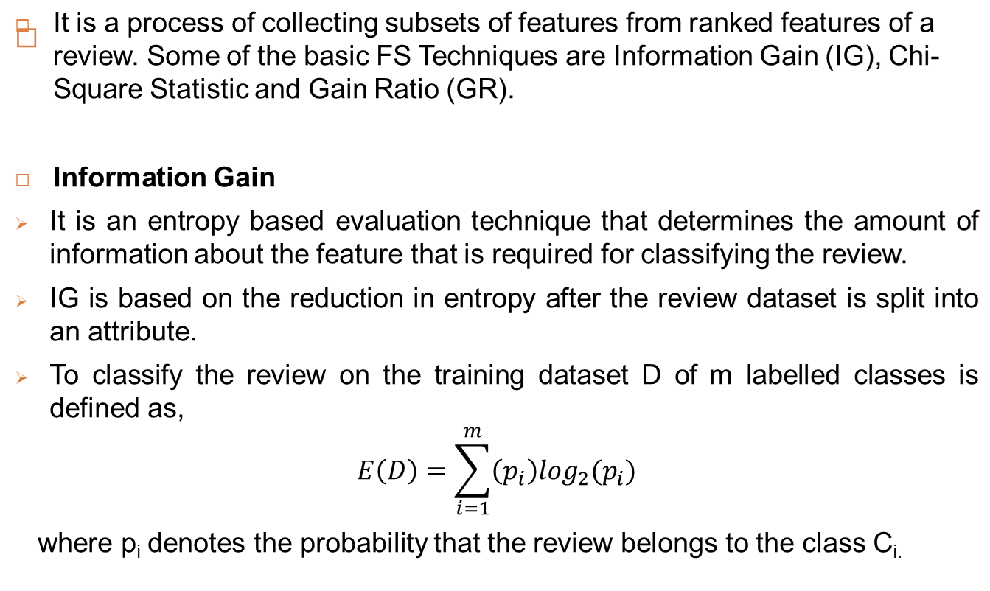

Slide 10

If the review in D on some feature fi has a set of values say, a₁, a₂, …, a_{v} then the dataset will split into D₁,D₂, …, D_{v} partitions set.
The amount of information expected to classify the reviews in the dataset which is used for training D and assuming the reviews are classified based on one feature f_{i} is,
The information gain on feature f_{i} is,

Slide 11
Sentiment Classification
K-Nearest Neighbors (KNN): In K-NN classification, the output is a class membership. An object is classified by a majority vote of its neighbors, with the object being assigned to the class most common among its k- nearest neighbors.
Decision Tree Classifier: Decision tree algorithm is based on the concept of information theory. The tree is built by taking the best splitting attribute at every stage. Best splitting attributes have been identified by using the information gain measure.

Slide 12

Sentiment Classification
Naive Bayes classifier: It uses Bayes Theorem to predict the probability that a given feature set belongs to a particular label. P(label) is the prior probability of a label. P(features|label) is the prior probability that a given feature set is being classified as a label. (features) is the prior probability that a given feature set is occurred.
Support Vector Machine: It is the non-probabilistic linear model. If the data points can't be separated linearly, then the kernel function will be used for classification. Therefore, the kernel function can be applied in SVM which maps the low dimensional non-linear data points into high dimensional linear data points. There are many kernel core functions: linear kernel, Gaussian kernel, Radial Basis Function (RBF) and so on.

Slide 13
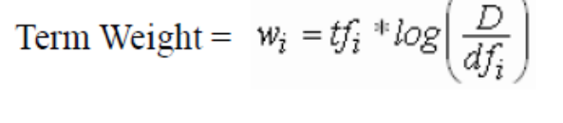
Term Weight – Global Information
Unlike the Term Count Model, Salton's Vector Space Model incorporates local and global information.
tf_{i}= term frequency (term counts) or number of times a term i occurs in a document. This accounts for local information.
df_{i}= document frequency or number of documents containing term i
D= number of documents in a database.
the df_{i} /Dratio is the probability of selecting a document containing a queried term from a collection of documents. This can be viewed as a global probability over the entire collection. Thus, the log(D/df_{i})term is the inverse document frequency, IDF_{i} and accounts for global information.

Slide 14
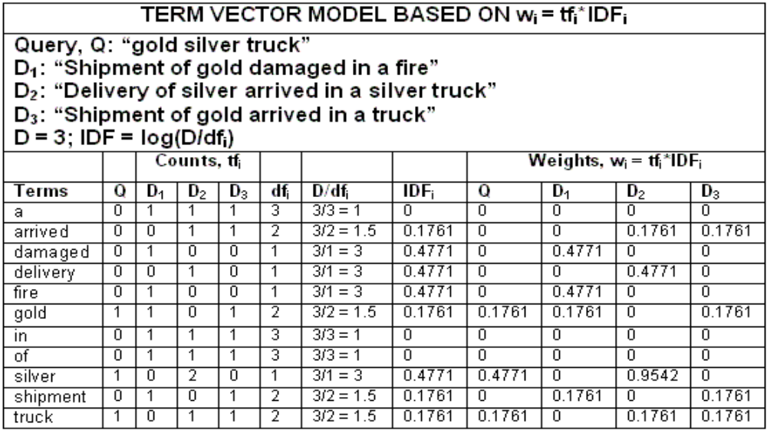
Document Search and Retrieval

Slide 15
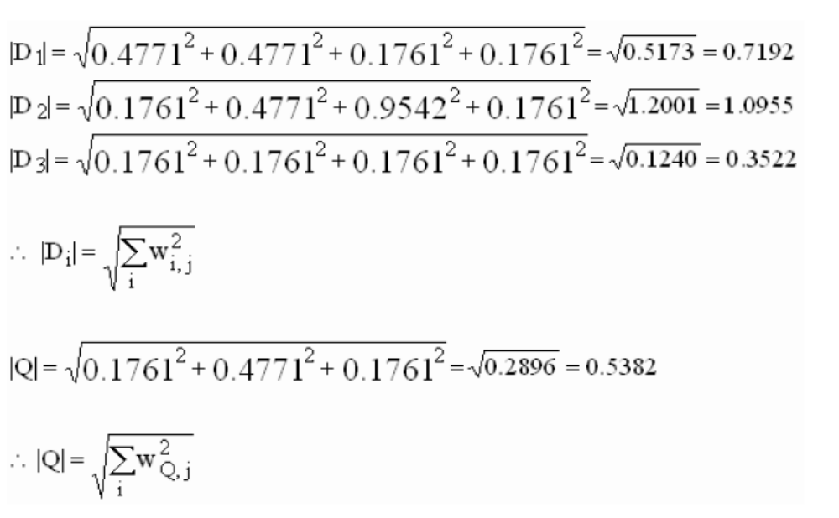
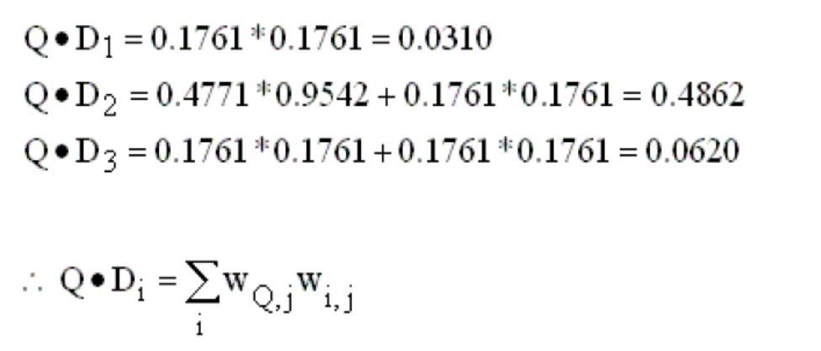
Similarity Analysis

Slide 16
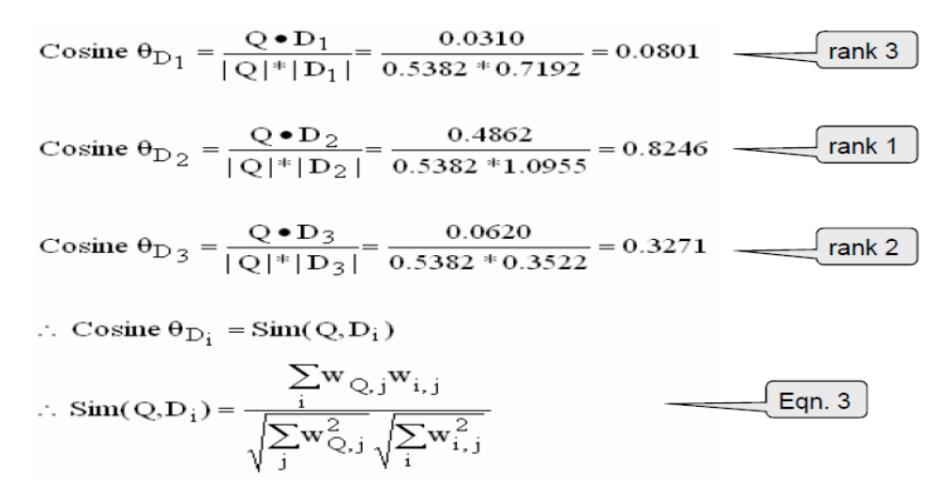
Similarity Analysis

Slide 17
Text Summarization
Text summarization is the process of shortening a text document, in order
to create a summary of the major points of the original document.
Summarization helps to reduce large text documents to a short set of words or a paragraph that conveys the meaning of the full text.

Slide 18
There are two methods used in automatic summarization:
The extractive method selects a subset of existing words, phrases or sentences in the original text to form summaries.
The abstractive method builds an internal semantic representation and uses natural language generation techniques to create summaries that resembles the ones created by humans.
This summary may have words that are not present in the original document.

Slide 19
Example:
Source text: Joseph and Mary rode on a donkey to attend the annual event in Jerusalem. In the city, Mary gave birth
to a child named Jesus.
Extractive summary: Joseph and Mary attend event Jerusalem. Mary birth Jesus.
Example:
Abstractive summary: Joseph and Mary came to Jerusalem where Jesus was born.

Slide 20
Extractive Text Summarization Example
movie reviews dataset:
Serial No | Review | Class
1 | This movie is fantastic! I really like it because story is so good. | 1
2 | not to my taste, will skip and watch another movie | 0
3 | Wow! i think they made this movie to torture people. there are no words for how much i hated this film. | 0
4 | Worst movie ever seen. Worst acting too. | 0

Slide 21
Pre-Processing :
POS (Part of Speech Tagging)
  process of assigning a word to its grammatical category. For above example:
  Words with tags :
  1. [('This', 'DT'), ('movie', 'NN'), ('is', 'VBZ'), ('fantastic', 'JJ'), ('!', '.'), ('I', 'PRP'), ('really', 'RB'), ('like', 'VBP'), ('it', 'PRP'), ('because', 'IN'), ('story', 'NN'), ('is', 'VBZ'), ('so', 'RB'), ('good', 'JJ')]
  2. [('not', 'RB'), ('to', 'TO'), ('my', 'PRP$'), ('taste', 'NN'), (',', ','), ('will', 'MD'), ('skip', 'VB'),
  ('and', 'CC'), ('watch', 'VB'), ('another', 'DT'), ('movie', 'NN')]
  3. [('Wow', 'UH'), ('!', '.'), ('i', 'LS'),('think', 'VB'), ('they', 'PRP'), ('made', 'VBD'), ('this', 'DT'), ('movie', 'NN'), ('to', 'TO'), ('torture', 'VB'), ('people', 'NNS‘), ('there', 'EX'), ('are', 'VBP'), ('no', 'DT'), ('words', 'NNS'),
  ('for', 'IN'), ('how', 'WRB'), ('much', 'JJ'), ('i', 'FW'), ('hated', 'VBN'), ('this', 'DT'), ('film', 'NN')]
  4. [('Worst', 'JJS'), ('movie', 'NN'), ('ever', 'RB'), ('seen', 'VBN'), ('Worst', 'JJS'), ('acting', 'VBG'), ('too', 'RB')]

Slide 22
Pre-Processing :
POS (Part of Speech Tagging)
  filter words based on (Noun , adjective and adverb)
  Reviews :
  ['movie is fantastic really like story is so good', 'not taste skip watch movie', 'think made movie torture people are words much hated film', 'Worst movie ever seen Worst acting too']

Slide 23
Pre-Processing :
Stop word Removal
  A stop word is a commonly used word (such as “the”, “a”, “an”, “in”) which have very little meaning .We cannot get any meaning from stop words.
  Reviews after stop word removal:
  ['movie fantastic really like story good', 'taste skip watch movie', 'think made movie torture people words much hated film', 'Worst movie ever seen Worst acting']

Slide 24
Feature Extraction (input data->set of features)
TF-IDF Technique
  This weight is a statistical measure used to evaluate how important a word is to a document in a collection or corpus.
  TF(t) = (Number of times term t appears in a document)
  (Total number of terms in the document)
  IDF (t) =loge (Total number of documents)
  ( Number of documents with term t in it).
  TF-IDF (t) = TF (t) * IDF (t).

Slide 25
Feature Extraction
TF-IDF Technique
  TF-IDF Features for movie dataset
  ['acting', 'fantastic', 'film', 'good', 'hated', 'like', 'movie', 'people', 'really', 'seen', 'skip', 'story', 'taste', 'think', 'torture', 'watch', 'words', 'worst']
  TF-IDF Matrix
 | f1 | f2 | f3 | f4 | f5 | f6 | f7 | f8 | f9 | f10 | f11 | f12 | f13 | f14 | f15 | f16 | f17 | f18
R1 | 0 | 0.43 | 0 | 0.43 | 0 | 0.43 | 0.22 | 0 | 0.43 | 0 | 0 | 0.43 | 0 | 0 | 0 | 0 | 0 | 0
R2 | 0 | 0 | 0 | 0 | 0 | 0 | 0.28 | 0 | 0 | 0 | 0.55 | 0 | 0.46 | 0 | 0 | 0.46 | 0 | 0.36
R3 | 0 | 0 | 0.39 | 0 | 0.39 | 0 | 0.20 | 0.39 | 0 | 0 | 0 | 0 | 0 | 0.39 | 0.39 | 0 | 0.39 | 0
R4 | 0.45 | 0 | 0 | 0 | 0 | 0 | 0.23 | 0 | 0 | 0.45 | 0 | 0 | 0 | 0 | 0 | 0 | 0 | 0.72

Slide 26
Feature Selection (set of features->most relevant feature)
Relief-F Algorithm
  Relief-f randomly selects an instance Xi then searches for its two closest neighbours, one neighbour it chooses from the same class that is called the closest hits H, and other one it chooses from the different class that is called closest misses M.
  Finally It updates the quality estimation of vector W for all attributes depending on their values for Xi, hits H and misses M of its nearest neighbours.
  Weight W estimation formula is :
  W [F] = W [F] – diff (F, Xi H)/n + diff (F, Xi, M)/n - ( I )
  Where, The diff (F, X1, X2) calculates the difference between
  the values of the Features F for two samples X1 and X2.

Slide 27
Feature Selection (set of features->most relevant feature)
Relief-F Algorithm on movie review features
  final features and their estimated weight list:
Feature Weight 'acting‘ : 1.38e-17 'fantastic': 1.0 'film‘ : 1.38e-17 'good‘ : 1.0 'hated‘ : 1.38e-17 'like‘ : 1.0 'movie‘ : 0.5 'people‘ : 1.38e-17 Sort features and 'really‘ : 1.0 consider top 10 'seen‘ : 1.38e-17 high weight age 'skip‘ : 2.77e-17 features 'story‘ : 1.0 'taste‘ : 2.77e-17 'think‘ :1.38e-17 'torture‘ :1.38e-17 'watch‘ : 2.77e-17 'words‘ : 1.38e-17 'worst‘ : 0.16 | Feature Weight 'fantastic‘ : 1.0 'good‘ : 1.0 'like‘ : 1.0 'really‘ : 1.0 'story‘ : 1.0 'movie‘ : 0.5 'worst‘ : 0.16 'skip‘ : 2.77e-17 'taste‘ : 2.77e-17 'watch‘ : 2.77e-17 ‘acting‘ :1.38e-17 'film‘ : 1.38e-17 'hated‘ : 1.38e-17 'people‘ : 1.38e-17 'seen‘ : 1.38e-17 'think‘ :1.38e-17 'torture‘ :1.38e-17 'words‘ :1.38e-17

Slide 28
Sentence Selection
Selection of sentences can be handled either:
  Supervised Methods
  Unsupervised Methods
We are using senti_word net dictionary based unsupervised method to extract the score of features.
If feature word exist then calculate score of word using equation (2) as given below
If feature word doesn't exist in senti_word net then find its synonyms in word net dictionary. If synonyms exist in senti_word net, add the score of synonyms to get final score of feature using equation (3) as given below.

Slide 29
Sentence Selection
To calculate the sentiment score there are two conditions:
  if word exist in senti_wordnet
  senti_score(W) = (PosScore – NegScore) - (2)
  If word doest exist in senti_wordnet
  senti_score(W) = (∑ PosScore – (∑NegScore) ) -(3)
  m+n
  where, m and n are number of positive synonym words and negative synonyms words respectively.

Slide 30
Sentence Selection
Top 10 Feature list
{'fantastic‘, 'good‘, 'like‘, 'really‘, 'story‘, 'movie‘, 'worst‘, 'skip‘, ‘taste‘, 'watch‘ }
Word score calculation using dictionary
  Score of features: { 0,0.5,0.1,0.25 ,0,0,-0.5, 0,0.5,0.375}
Sentence Score calculation
  R1 = This movie is fantastic! I really like it because story is so good.
  features matched = {movie , fantastic ,really ,like ,story, good}
  R1 score = 0+0+0.15+0.1+0+0.5 = 0.75
  R2 = not to my taste, will skip and watch another movie
  features matched = {taste ,movie ,skip ,watch}
  R2 score = 0.5+0+0+0.375 = 0.875
  R3 = Wow! i think they made this movie to torture people. there are no words for how much i hated this film
  features matched = {movie}
  R3 Score = 0
  R4 = 'Worst movie ever seen Worst acting too
  features matched = { worst ,movie}
  R5 = -0.5 +0 = -0.5

Slide 31
Final Summary
Sentence Score after sorted in descending order
R2 = 0.875
R1 = 0.75
R3 = 0
R4 = -0.5
  Top ranked Sentences
  not to my taste, will skip and watch another movie. This movie is fantastic! I really like it because story is so good. Wow! i think they made this movie to torture people. there are no words for how much i hated this film. Worst movie ever seen. Worst acting too.
  As document size is small ,let’s take top one ranked sentence in final summary which is enough to tell that maximum reviews of dataset are negatives.

Slide 32
Thank you

